Slide 1
Project Presentation of IOHE
On
Smart Campus
Abhishek Kumar (2210991167)
Supervised By: Dr. Shikha Tuteja
Department of Computer Science and Engineering,
Chitkara University, Punjab

Slide 2
Introduction
1.1 Background
Manual Management: Seminar halls and study rooms are managed manually without a proper system.
Availability Problems: Students do not know if a room is available in real time, which causes wasted time and booking clashes.
Poor Resource Usage: Some users keep spaces occupied for too long because there are no time limits.
Lack of Monitoring: There is no central system to track room usage or make sure all students get fair access to facilities.
1.2 Problem Statement
Centralized Management: Create one digital system to easily book and manage shared college spaces.
Role-Based Governance: Use roles like “Community Head” and “Community Member” to manage activities and responsibilities properly.
Fairness & Transparency: Improve campus management by giving real-time updates and proper monitoring so everyone gets fair access to resources.
.
2

Slide 3
Objectives
The main objectives of Smart Campus are to improve the management and utilization of shared university spaces through a smart and centralized digital platform.
Digital Management: Develop a digital system for booking and managing shared university spaces efficiently.
Role-Based Access: Organize users through roles such as Community Head and Community Member for better management and coordination.
Fair Resource Allocation: Provide fair and transparent access to seminar halls and study rooms for all users.
Efficient Monitoring: Improve the monitoring and utilization of university resources through centralized management.
Time-Based Usage Control: Set proper time limits for room usage to avoid unnecessary occupation and ensure better availability.

Slide 4
Proposed Solution
The proposed system is a smart digital platform designed to manage shared university spaces such as seminar halls, study rooms, and meeting rooms in an easy and organized way. The system helps students and administrators book, monitor, and manage spaces efficiently without manual work.
Main Functions of the System:-
Online Room Booking: Students and faculty can book seminar halls or study rooms online through the system without visiting the office physically.
Real-Time Availability Checking: Users can instantly check whether a room is available or already booked, which helps avoid confusion and scheduling conflicts.
Time-Based Booking System: The system allows bookings for a limited time period so that resources are used fairly and no one occupies a room for too long.
Role-Based Access: Different roles such as Community Head and Community Member are provided to manage activities in a structured way. Community Heads can monitor and approve bookings if required.
4

Slide 5
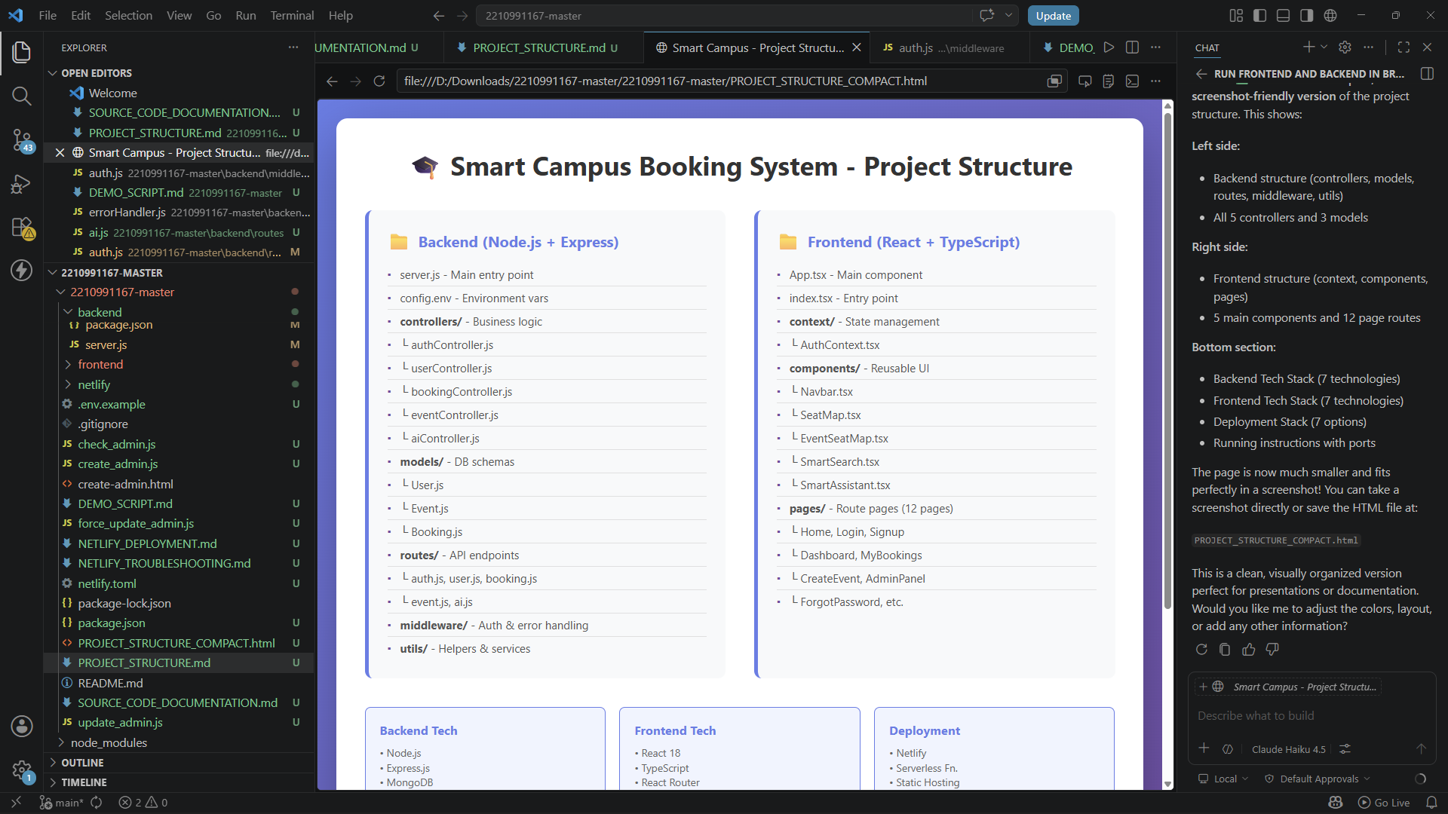
Project Structure

Slide 6
TECHNOLOGIES AND TOOLS
Smart Campus is built using the MERN Stack, which provides a scalable, secure, and centralized platform for managing shared university resources efficiently.
Technologies:-
React.js (with Vite): Used to create a fast, dynamic, and user-friendly interface.
Node.js & Express.js: Handles the server-side operations of the application.
MongoDB: A NoSQL database used to store application data efficiently.
JWT (JSON Web Tokens): Used for secure user authentication and authorization.
Tailwind CSS: Used for designing a clean, responsive, and professional interface.
REST APIs: Enable smooth communication between the frontend and backend.

Slide 7
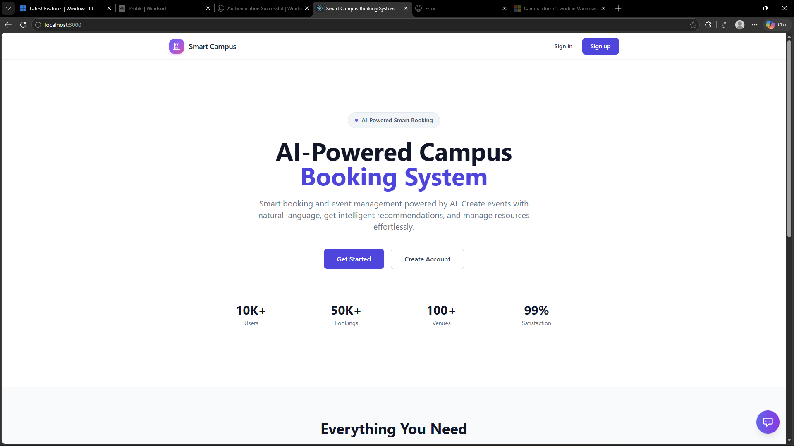
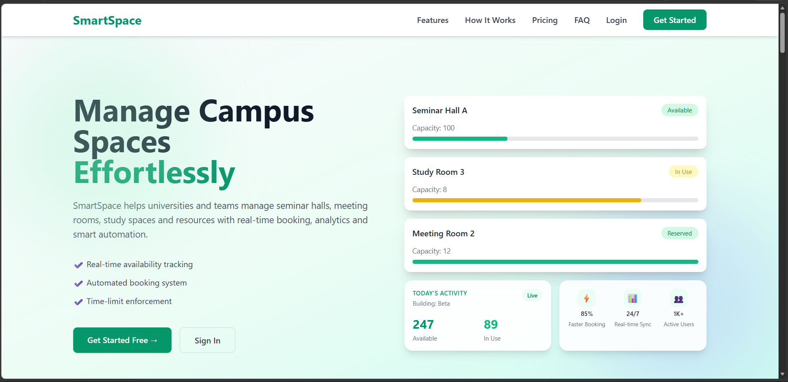
VISUAL REPRESENTATION

Slide 8
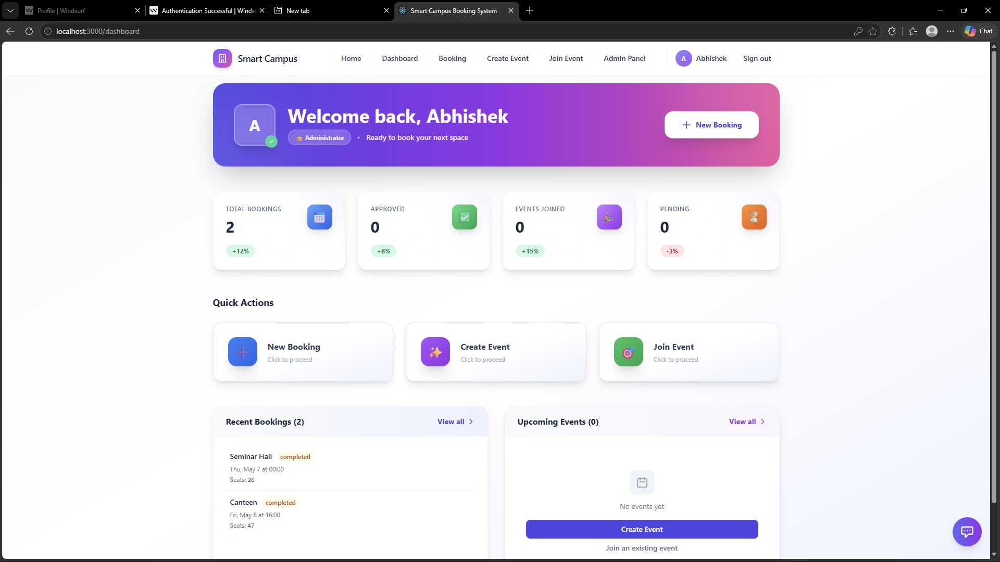
VISUAL REPRESENTATION

Slide 9
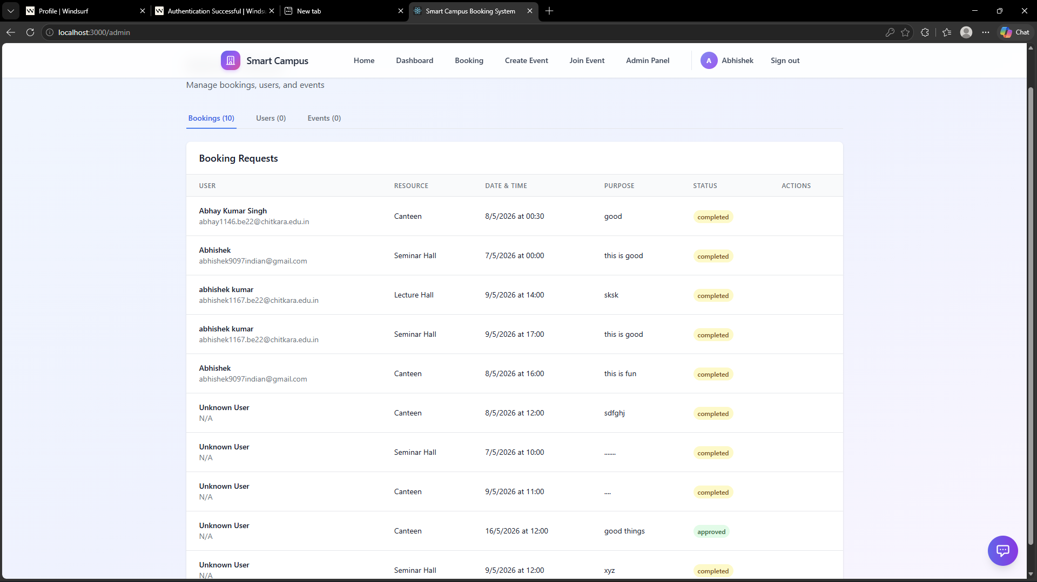
VISUAL REPRESENTATION

Slide 10
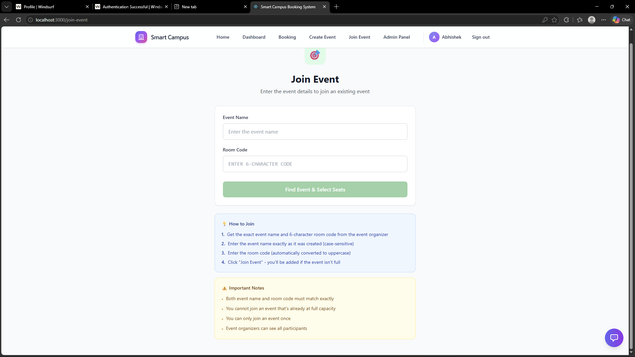
VISUAL REPRESENTATION

Slide 11
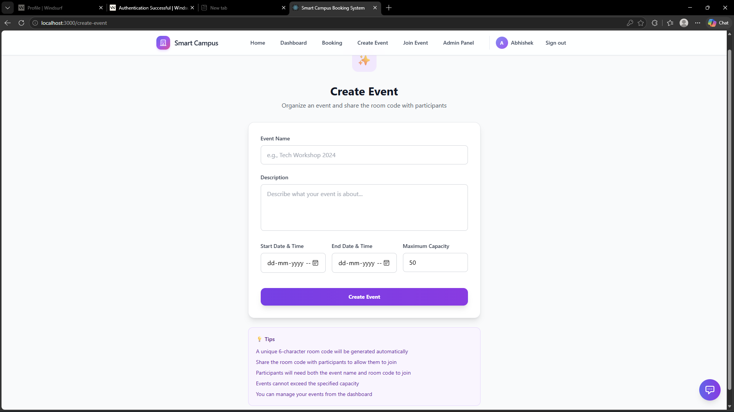
VISUAL REPRESENTATION

Slide 12
Future Scope
• Mobile Application: Development of native mobile applications for Android and iOS to provide better accessibility and enable users to book resources and manage events on the go.
• Advanced Analytics: Implementation of detailed analytics with graphical insights to help administrators track resource usage, booking trends, and optimize utilization.
• IoT Integration: Integration with smart devices such as automated entry systems or smart displays to provide real-time updates on room availability and bookings.
• Multi-language Support: Adding support for multiple languages to make the platform accessible to a wider range of users across different regions.
• Notification System: Introducing real-time notifications for booking confirmations, status updates, and event reminders.
• Custom Resource Management: Allowing administrators to create and configure custom resources, seating layouts, and booking rules based on institutional needsportals and student IDs.

Slide 13
Conclusion
• The Smart Campus Booking System successfully addresses the challenges of managing campus resources and event coordination within educational institutions. By integrating real-time seat availability, resource booking, and event management, the system provides an efficient and practical solution for organizing campus activities.
• The platform ensures that users can book resources without conflicts through realtime seat selection and structured booking processes. Its organized approach, combined with role-based access and administrative control, helps maintain transparency and efficient utilization of resources.
• Built using modern web technologies, the system is scalable, efficient, and easy to maintain. The Smart Campus Booking System demonstrates how technology can be effectively utilized to improve resource management and operational efficiency in institutional environments, making it a valuable solution for modern campuses.

Slide 14
Bibliography/References
React (Official Documentation) Meta. React – A JavaScript Library for Building User Interfaces. https://react.dev
Vite (Official Documentation) Evan You. Vite – Next Generation Frontend Tooling. https://vitejs.dev
Tailwind CSS (Official Documentation) Tailwind Labs. Tailwind CSS – Utility-First CSS Framework. https://tailwindcss.com/docs
MongoDB (Official Documentation): MongoDB Inc. The Document Database for Modern Applications.
https://www.mongodb.com/docs
Express.js (Official Documentation) OpenJS Foundation. Express – Fast, Unopinionated Web Framework for Node.js. https://expressjs.com
Node.js (Official Documentation): OpenJS Foundation. Node.js – JavaScript Runtime built on Chrome's V8 JavaScript engine.
https://nodejs.org/en/docs

Slide 15
Thank You
15

